Slide 1



fullstackdatascience.com
Basic Excel for Data Analysis
Essential Tools for Data Analysis
Created by Huydata
DA K6
Lesson 3
huynt@fullstackdatascience.com
1

Slide 2

Learn
About
01/
Introduction to Excel
02/
Pivot Table
03/
Connecting SQL Server to Google Sheets
fullstackdatascience.com
2

Slide 3

Introduction to Excel Interface
and Excel Tables
Microsoft Excel
Excel is a spreadsheet program developed by Microsoft that organizes data in rows and columns, allowing users to perform calculations, analysis, and data visualization.
3

Slide 4
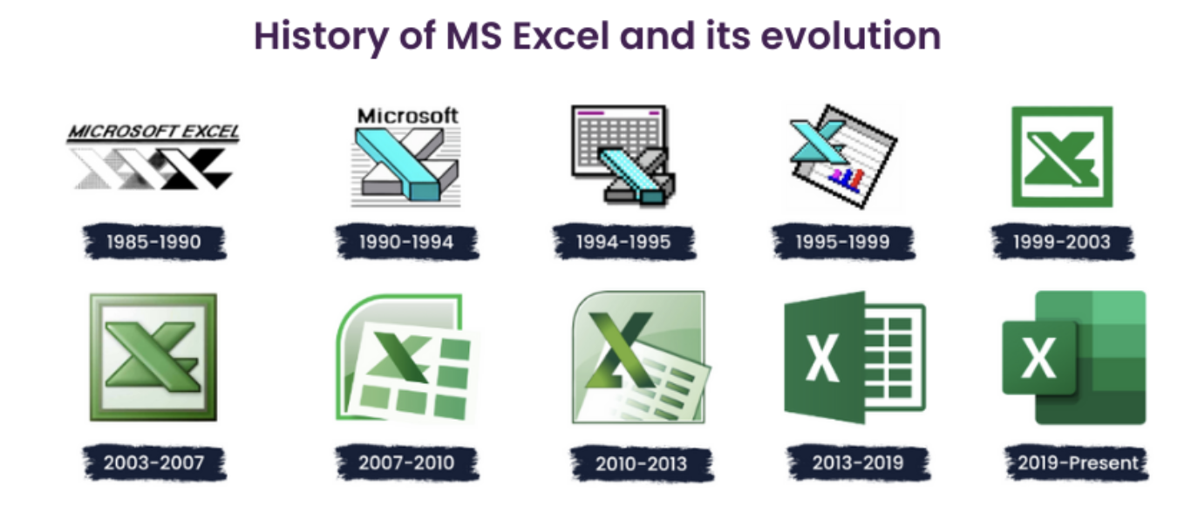
History of Microsoft Excel
1985 - 1990: The Beginning on Macintosh (before a Windows version existed)
1990–1999 : Adapting to Windows
1999–2010 : The Classic Office Era (In 2007, the Ribbon UI was introduced — a major interface change)
2010–2019 : The Modernization Phase (Logos and interface design became flatter and cleaner)
5

Slide 5
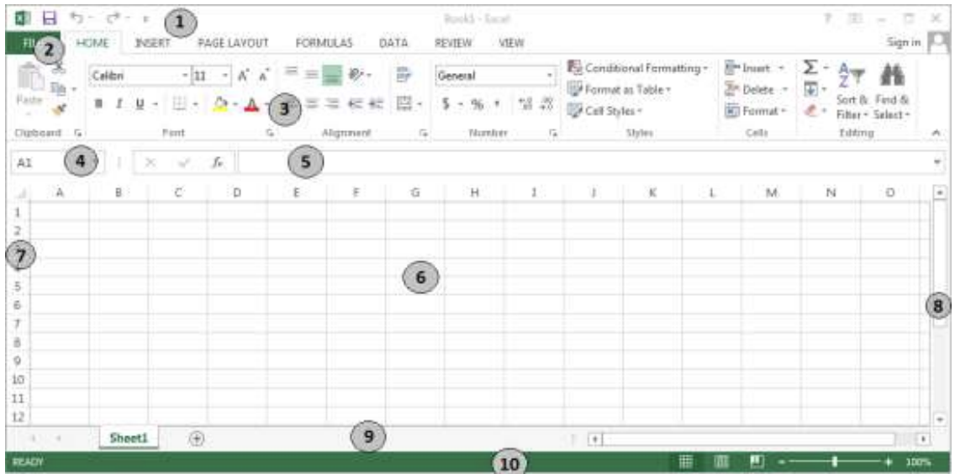
Excel Interface
(3): Ribbon Toolbar – Contains nearly all of the program’s commands, organized into different groups based on functionality.
(5): Formula Bar – The area where you enter or view cell formulas.
(6): Data Entry Area – The main part of the screen, where the spreadsheet data is displayed (Worksheet).
(9): Sheet Tab Bar – Lists all the worksheets in the Excel file (Workbook); also includes navigation buttons to move between sheets.
5

Slide 6
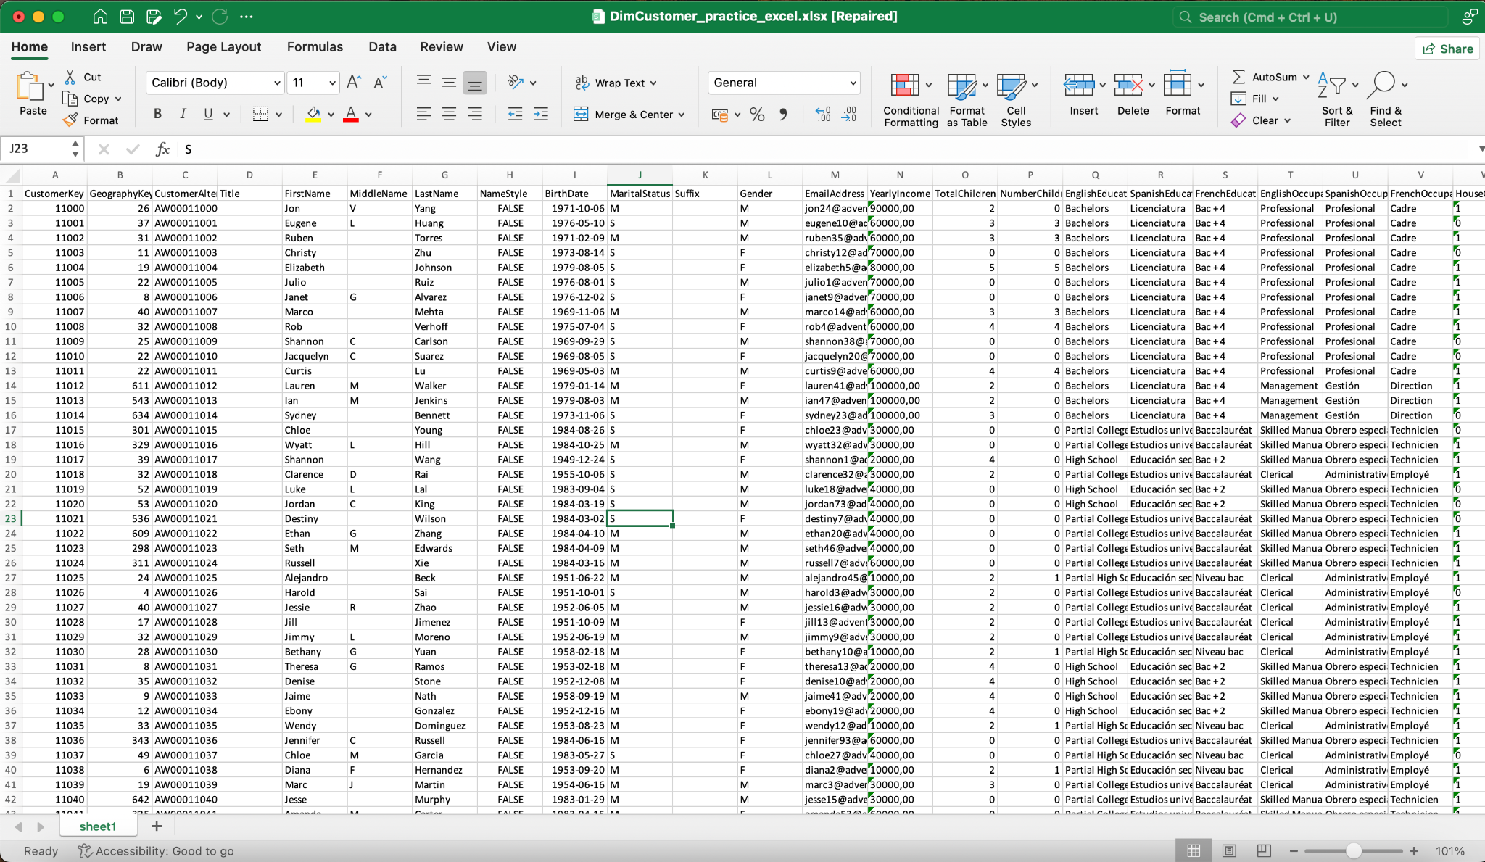

Excel Table - Practices
DimCustomer
Sorting and Filtering
Essential Excel Functions
5

Slide 7
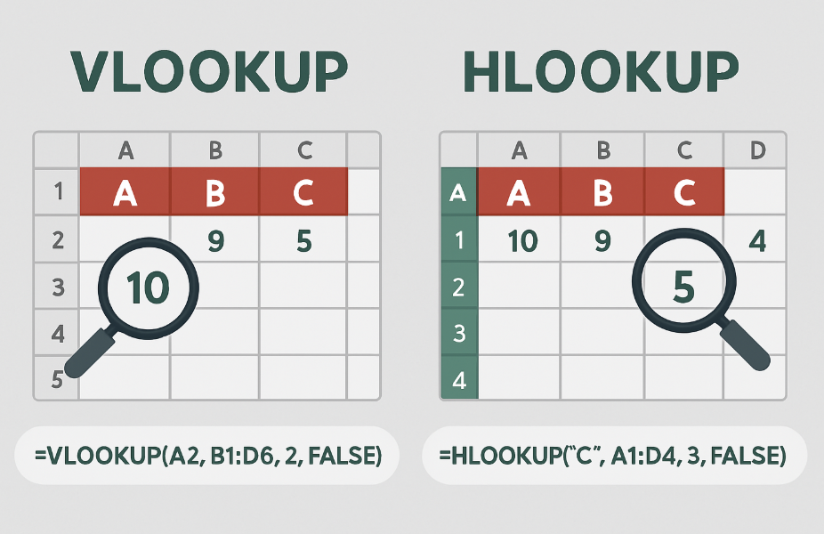
VLOOKUP = looks vertically 🔽
HLOOKUP = looks horizontally ▶️
Both are essential tools to fetch specific info from big tables—fast and smart!
5

Slide 8
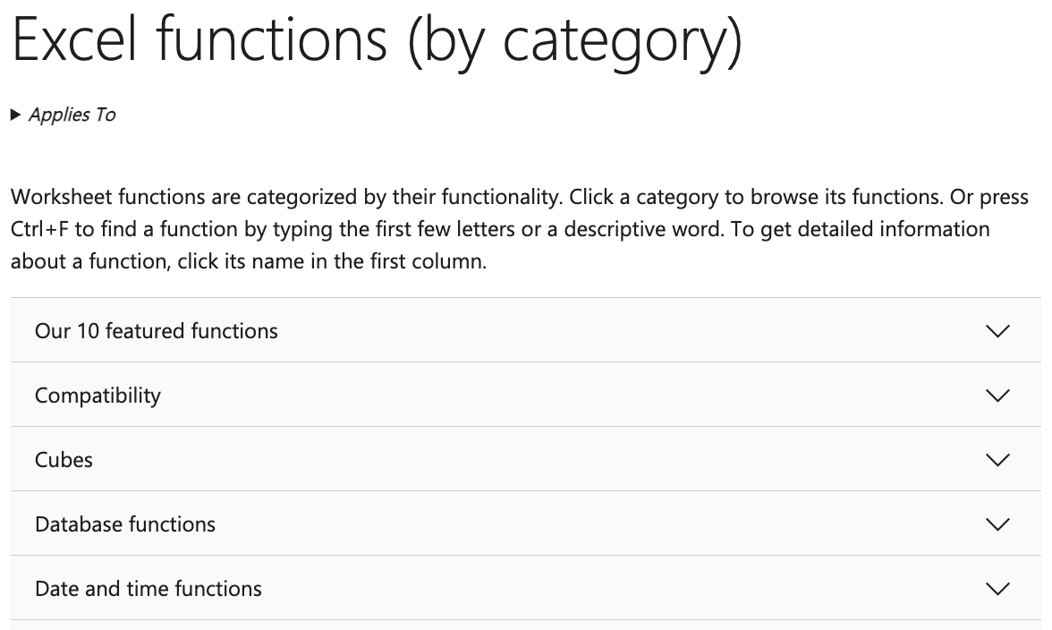
PRACTICES
https://support.microsoft.com/en-us/office/excel-functions-by-category-5f91f4e9-7b42-46d2-9bd1-63f26a86c0eb
https://support.microsoft.com/en-us/office/excel-functions-alphabetical-b3944572-255d-4efb-bb96-c6d90033e188
4

Slide 9

PIVOT TABLE
3

Slide 10

Pivot Table
A Pivot Table is a powerful Excel tool that lets you quickly summarize, analyze, and explore data from a large dataset.
Why it's useful? Turn rows of raw data into summaries Spot patterns and trends easily Flexible: group, filter, sort, calculate
5

Slide 11
Pivot Table Exercise
Sales Data Analysis
Create a Pivot Table from the original dataset.
1. Summarize total revenue by each region.
2. Display detailed revenue by product within each region.
3. Calculate the total quantity sold by each salesperson.
4. Filter the data to display only transactions from Ho Chi Minh City (TP.HCM).
5. Setup Slicer
5

Slide 12
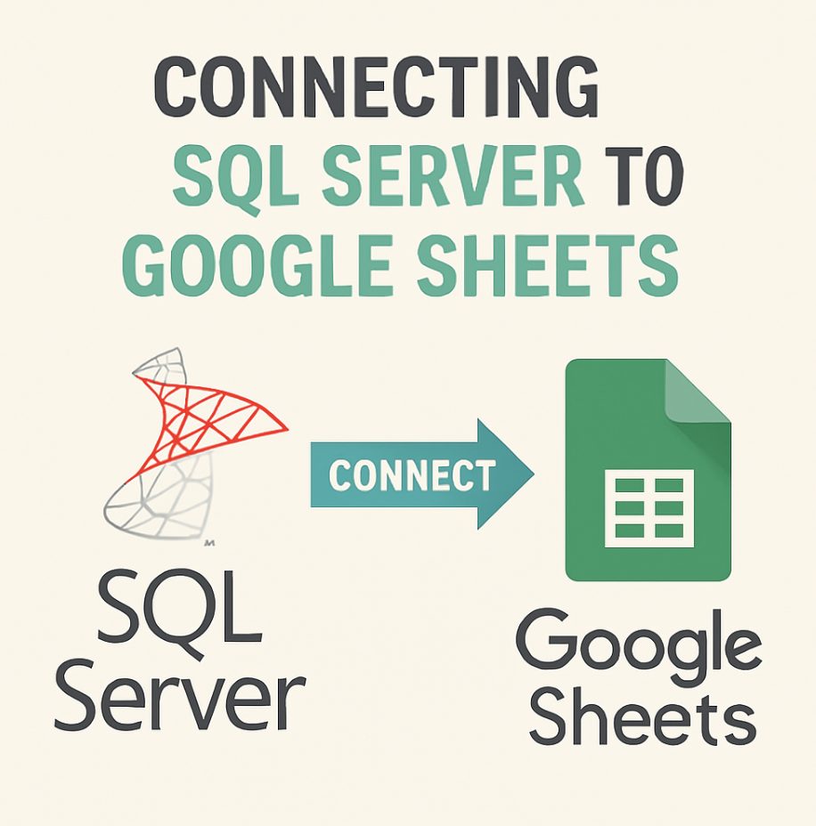
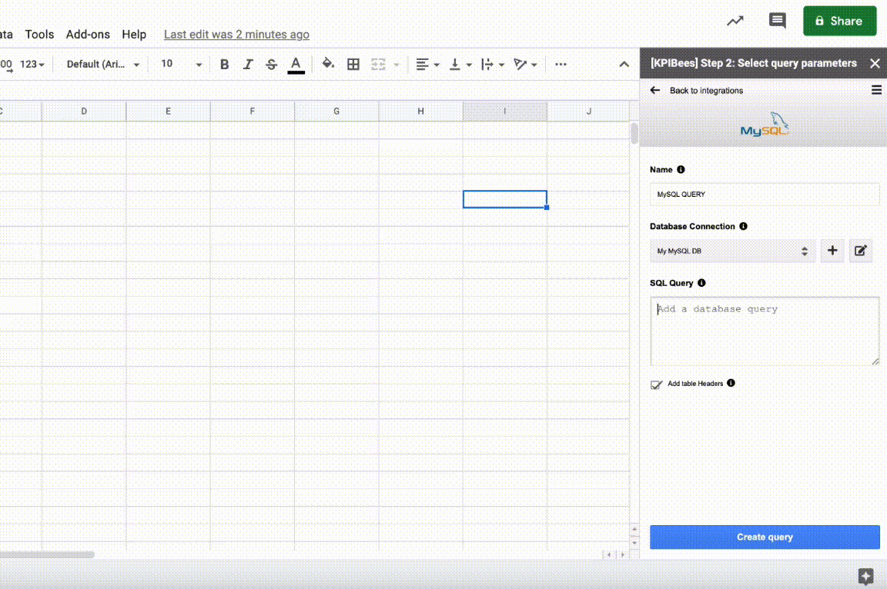
3

Slide 13
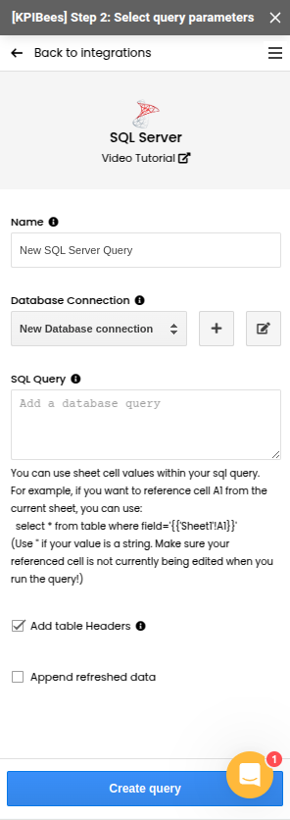
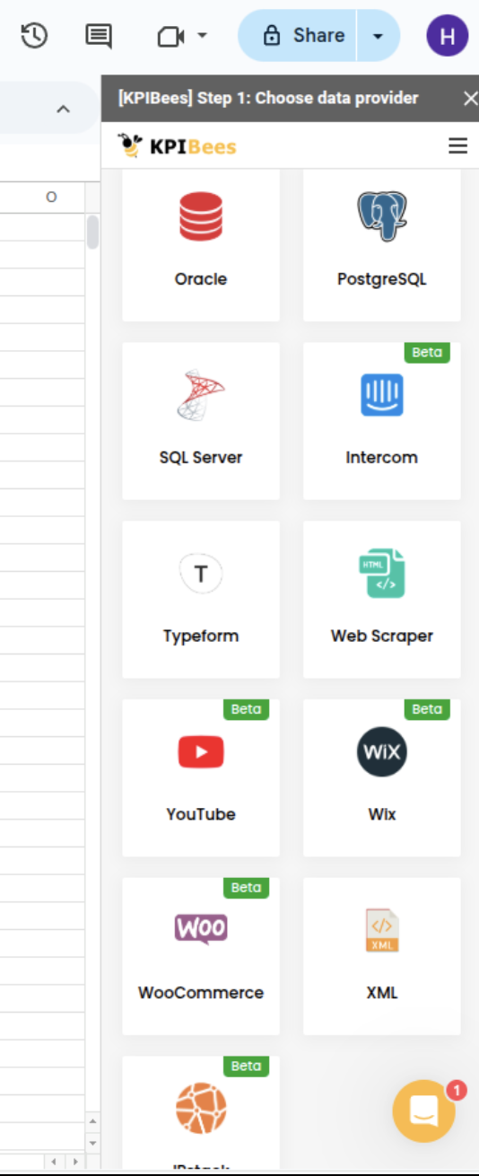
KPIBees
QUERY
5

Slide 14
QUERY IN GOOGLE SHEET
= QUERY(range, "SQL-like query", [headers])
range: vùng dữ liệu (ví dụ: A1:F100)
"SQL-like query": chuỗi truy vấn (dùng cú pháp gần giống SQL)
headers: số dòng tiêu đề (thường là 1)
5

Slide 15
QUERY IN GOOGLE SHEET
Sheet Saledata: https://docs.google.com/spreadsheets/d/1zHNeg9OdUPNS_9OsxqRjaU4l-OLEbWmKhj30u_7zSz4/edit?gid=547999869#gid=547999869
✅ 1. Chọn toàn bộ dữ liệu =QUERY(SalesData!A1:F100, "SELECT *", 1)
✅ 2. Lọc dữ liệu ở TP.HCM =QUERY(SalesData!A1:F100, "SELECT * WHERE B = 'TP.HCM'", 1)
✅ 3. Tổng doanh thu theo khu vực =QUERY(SalesData!A1:F100, "SELECT B, SUM(F) GROUP BY B", 1)
5

Slide 16

fullstackdatascience.com
References
https://cloud.google.com/bigquery/docs
https://datahubproject.io/docs/
11

Slide 17





Thank you
096 574 90 25
CREATED BY
Nguyen Tien Huy
info@robusto.ai
fullstackdatascience
huynt@fullstackdatascience.com
Data Manager
https://fullstackdatascience.com/
Hanoi, Vietnam

